Slide 1
Java Classes
Sunanda Das
Assistant Professor
Dept. of CSE, KUET
Argha Dhar
Lecturer
Dept. of CSE, KUET

Slide 2
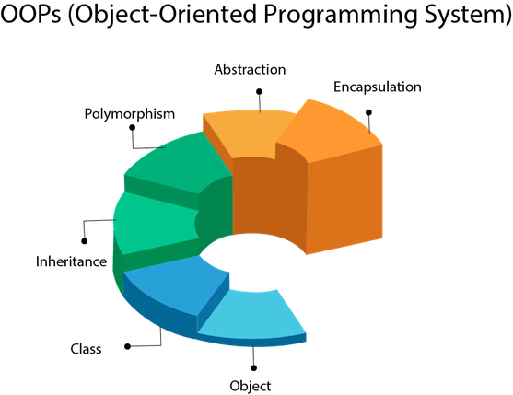
Object-Oriented Programming(OOP)
Object means a real-world entity such as a pen, chair, table, computer, watch, etc.
Object-Oriented Programming is a methodology or paradigm to design a program using classes and objects.
It simplifies software development and maintenance by providing some concepts:
Object
Class
Inheritance
Polymorphism
Abstraction
Encapsulation

Slide 3
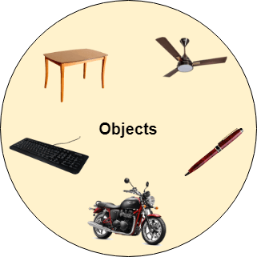
Java Classes/ Objects
public class Main { int x = 5; public static void main(String[] args) { Main myObj1 = new Main(); // Object 1 Main myObj2 = new Main(); // Object 2 System.out.println(myObj1.x); System.out.println(myObj2.x); } }

Slide 4
Java Class Attributes
public class Main { int x = 10; public static void main(String[] args) { Main myObj = new Main(); myObj.x = 25; // x is now 25 System.out.println(myObj.x); } }

Slide 5
Java Class Attributes(Cont.)
public class Main { final int x = 10; public static void main(String[] args) { Main myObj = new Main(); myObj.x = 25; // will generate an error: cannot assign a value to a final variable System.out.println(myObj.x); } }

Slide 6
Java Class Methods
public class Main { // Static method static void myStaticMethod() { System.out.println("Static methods can be called without creating objects"); } // Public method public void myPublicMethod() { System.out.println("Public methods must be called by creating objects"); } // Main method public static void main(String[] args) { myStaticMethod(); // Call the static method // myPublicMethod(); This would compile an error Main myObj = new Main(); // Create an object of Main myObj.myPublicMethod(); // Call the public method on the object } }

Slide 7
Java Constructors
public class Main { int modelYear; String modelName; public Main(int year, String name) { modelYear = year; modelName = name; } public static void main(String[] args) { Main myCar = new Main(1969, "Mustang"); System.out.println(myCar.modelYear + " " + myCar.modelName); } } // Outputs 1969 Mustang
A constructor in Java is a special method that is used to initialize objects
The constructor is called when an object of a class is created
constructor name must match the class name
It cannot have return type

Slide 8
Java Packages
A java package is a group of similar types of classes, interfaces and sub-packages.
Advantage of Java Package
Java package is used to categorize the classes and interfaces so that they can be easily maintained.
Java package provides access protection.
Java package removes naming collision.

Slide 9
Java Packages(Cont.)
Packages are divided into two parts:
Built-in packages: In java, we already have various pre-defined packages and these packages contain large numbers of classes and interfaces that we used in java are known as Built-in packages.
User-defined packages: As the name suggests user-defined packages are a package that is defined by the user or programmer.

Slide 10

Java Packages(Cont.)
import java.awt.*; public class AWTExample{ AWTExample() { Frame fr1=new Frame(); Label la = new Label("Welcome to the java graphics GEEKSFORGEEKS"); fr1.add(la); fr1.setSize(200, 200); fr1.setVisible(true); } public static void main(String args[]) { Testawt tw = new Testawt(); } }

Slide 11
Java Packages(Cont.)
//save by A.java package pack; public class A{ public void msg(){System.out.println("Hello");} }
//save by B.java package mypack; import pack.*; class B{ public static void main(String args[]){ A obj = new A(); obj.msg(); } }

Slide 12
Java Access Modifiers
Access Modifier | within class | within package | outside package by subclass only | outside package
Private | Y | N | N | N
Default | Y | Y | N | N
Protected | Y | Y | Y | N
Public | Y | Y | Y | Y

Slide 13
Java Access Modifiers(Cont.)
Private: The access level of a private modifier is only within the class. It cannot be accessed from outside the class.
Default: The access level of a default modifier is only within the package. It cannot be accessed from outside the package. If you do not specify any access level, it will be the default.
Protected: The access level of a protected modifier is within the package and outside the package through child class. If you do not make the child class, it cannot be accessed from outside the package.
Public: The access level of a public modifier is everywhere. It can be accessed from within the class, outside the class, within the package and outside the package.

Slide 14
Java Encapsulation
public class Person { private String name; // Getter public String getName() { return name; } // Setter public void setName(String newName) { this.name = newName; } }
public class Main { public static void main(String[] args) { Person myObj = new Person(); myObj.name = "John"; // error System.out.println(myObj.name);// error } }
public class Main { public static void main(String[] args) { Person myObj = new Person(); myObj.setName("John"); // Set the value of the name variable to "John" System.out.println(myObj.getName()); } }

Slide 15
‘this’ keyword
class Student{ int rollno; String name; float fee; Student(int rollno,String name,floatfee){ this.rollno=rollno; this.name=name; this.fee=fee; }
class Student{ int rollno; String name; float fee; Student(int r,String n,float f){ rollno=r; name=n; fee=f; }

Slide 16
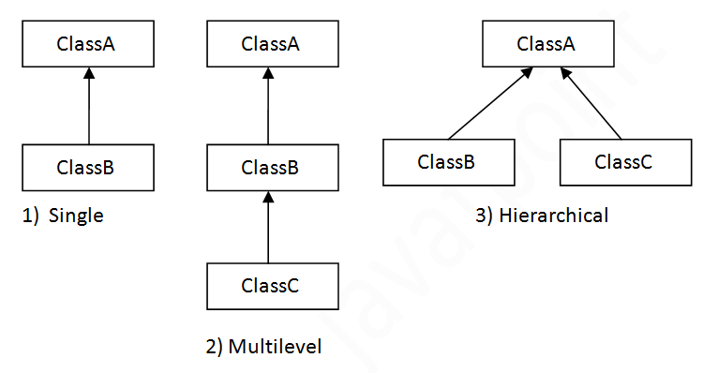
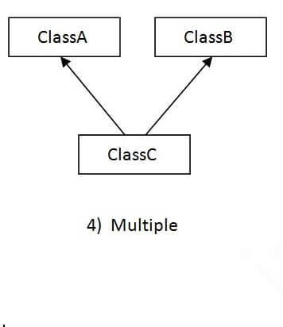
Inheritance

Slide 17
Single Inheritance
class Vehicle { protected String brand = "Ford"; // Vehicle attribute public void honk() { // Vehicle method System.out.println("Tuut, tuut!"); } } class Car extends Vehicle { private String modelName = "Mustang"; // Car attribute public static void main(String[] args) { Car myCar = new Car(); myCar.honk(); System.out.println(myCar.brand + " " + myCar.modelName); } }

Slide 18
Super()
class Animal { private String name; // Constructor in the superclass public Animal(String name) { this.name = name; System.out.println("Animal constructor"); } public String getName() { return name; } } class Dog extends Animal { private String breed; // Constructor in the subclass public Dog(String name, String breed) { super(name); // Call the superclass constructor this.breed = breed; System.out.println("Dog constructor"); } public String getBreed() { return breed; } } public class Main { public static void main(String[] args) { Dog myDog = new Dog("Buddy", "Labrador"); System.out.println("Name: " + myDog.getName()); System.out.println("Breed: " + myDog.getBreed()); } }

Slide 19
Why multiple inheritance is not supported in Java?
class A{ void msg(){System.out.println("Hello");} } class B{ void msg(){System.out.println("Welcome");} } class C extends A,B{//suppose if it were public static void main(String args[]){ C obj=new C(); obj.msg();//Now which msg() method would be invoked? } }

Slide 20
Aggregation
public class Address { String city,state,country; public Address(String city, String state, String country) { this.city = city; this.state = state; this.country = country; } }
public class Emp { int id; String name; Address address; public Emp(int id, String name,Address address) { this.id = id; this.name = name; this.address=address; } void display(){ System.out.println(id+" "+name); System.out.println(address.city+" "+address.state+" "+address.country); } public static void main(String[] args) { Address address1=new Address("gzb","UP","india"); Address address2=new Address("gno","UP","india"); Emp e=new Emp(111,"varun",address1); Emp e2=new Emp(112,"arun",address2); e.display(); e2.display(); } }

Slide 21
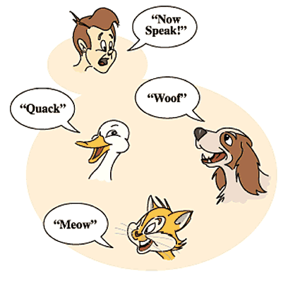
Polymorphism
class Animal { public void animalSound() { System.out.println("The animal makes a sound"); } }
class Main { public static void main(String[] args) { Animal myAnimal = new Animal(); // Create a Animal object Animal myPig = new Pig(); // Create a Pig object Animal myDog = new Dog(); // Create a Dog object myAnimal.animalSound(); myPig.animalSound(); myDog.animalSound(); } }
class Pig extends Animal { public void animalSound() { System.out.println("The pig says: wee wee"); } }
class Dog extends Animal { public void animalSound() { System.out.println("The dog says: bow wow"); } }

Slide 22
Inner Class
class OuterClass { int x = 10; class InnerClass { int y = 5; } } public class Main { public static void main(String[] args) { OuterClass myOuter = new OuterClass(); OuterClass.InnerClass myInner = myOuter.new InnerClass(); System.out.println(myInner.y + myOuter.x); } } // Outputs 15 (5 + 10)

Slide 23
Abstraction
// Abstract class abstract class Animal { // Abstract method (does not have a body) public abstract void animalSound(); // Regular method public void sleep() { System.out.println("Zzz"); } } // Subclass (inherit from Animal) class Pig extends Animal { public void animalSound() { // The body of animalSound() is provided here System.out.println("The pig says: wee wee"); } } class Main { public static void main(String[] args) { Pig myPig = new Pig(); // Create a Pig object myPig.animalSound(); myPig.sleep(); } }
Data abstraction is the process of hiding certain details and showing only essential information to the user.
Abstract class: is a restricted class that cannot be used to create objects (to access it, it must be inherited from another class).
Abstract method: can only be used in an abstract class, and it does not have a body. The body is provided by the subclass (inherited from).

Slide 24
Interface
// Interface interface Animal { public void animalSound(); // interface method (does not have a body) public void sleep(); // interface method (does not have a body) } // Pig "implements" the Animal interface class Pig implements Animal { public void animalSound() { // The body of animalSound() is provided here System.out.println("The pig says: wee wee"); } public void sleep() { // The body of sleep() is provided here System.out.println("Zzz"); } } class Main { public static void main(String[] args) { Pig myPig = new Pig(); // Create a Pig object myPig.animalSound(); myPig.sleep(); } }
Like abstract classes, interfaces cannot be used to create objects
Interface methods do not have a body - the body is provided by the "implement" class
On implementation of an interface, you must override all of its methods
An interface cannot contain a constructor (as it cannot be used to create objects)
Java does not support "multiple inheritance" (a class can only inherit from one superclass). However, it can be achieved with interfaces

Slide 25
Interface(Cont.)
interface FirstInterface { public void myMethod(); // interface method } interface SecondInterface { public void myOtherMethod(); // interface method } class DemoClass implements FirstInterface, SecondInterface { public void myMethod() { System.out.println("Some text.."); } public void myOtherMethod() { System.out.println("Some other text..."); } } class Main { public static void main(String[] args) { DemoClass myObj = new DemoClass(); myObj.myMethod(); myObj.myOtherMethod(); } }

Slide 26
check Instance
class Animal { } class Dog extends Animal { } class Cat extends Animal { } public class Main { public static void main(String[] args) { Animal dog = new Dog(); Animal cat = new Cat(); System.out.println(dog instanceof Animal); // true System.out.println(dog instanceof Dog); // true System.out.println(cat instanceof Animal); // true System.out.println(cat instanceof Cat); // true System.out.println(dog instanceof Cat); // false System.out.println(cat instanceof Dog); // false } }

Slide 27
References
Reference 1
Reference 2

